Slide 1



End-to-end Reliability of
Non-deterministic Stateful Components
Ph.D. Dissertation Defense,
24 September 2010
Sumant Tambe
sutambe@dre.vanderbilt.edu
www.dre.vanderbilt.edu/~sutambe
Department of Electrical Engineering & Computer Science
Vanderbilt University, Nashville, TN, USA
Notes:
1
Good afternoon everyone. Today, I’ll talk about two topics from my dissertation, which is on Model-driven fault-tolerance for DRE systems. First, I’ll begin with a highly systems-oriented topic of end-to-end reliability of non-deterministic stateful components.

Slide 2
Presentation Road-map
Overview of the Contributions
The Orphan Request Problem
  Related Research & Unresolved Challenges
  Solution: Group-failover
Typed Traversal
  Related Research & Unresolved Challenges
  Solution: LEESA
Concluding Remarks
Notes:
2
I’ll discuss what is known as the orphan request problem. I’ll present the group-failover solution for DRE systems. The second topic today is highly software oriented. Typed traversal. It fits nicely in the overall theme of the dissertation: model-driven engineering.

Slide 3
Dissertation Contributions: Model-driven Fault-tolerance
Resolves challenges in
Component QoS Modeling Language (CQML)
  Aspect-oriented Modeling for Modularizing QoS Concerns
Specification
Composition
Generative Aspects for Fault-Tolerance (GRAFT)
  Multi-stage model-driven development process
  Weaves dependability concerns in system artifacts
  Provides model-to-model, model-to-text, model-to-code transformations
Deployment
Configuration
The Group-failover Protocol
  Resolves the orphan request problem
Run-time
3
Notes:
Let me quickly review what I’ve presented in the past. During my proposal I presented CQML and GRAFT, which address the challenges in earlier phases of the development lifecycle. The group-failover was the proposed topic addressing the challenges in the run-time phase.

Slide 4
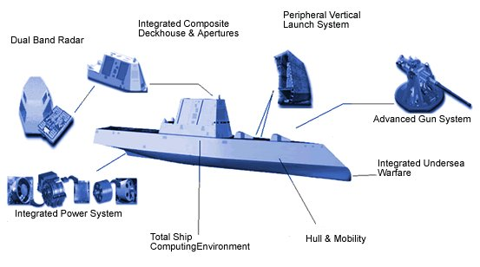
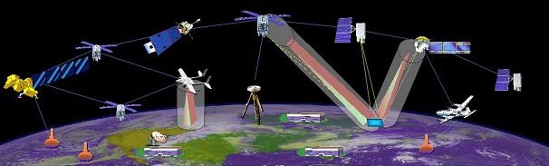

Context: Distributed Real-time Embedded (DRE) Systems
Heterogeneous soft real-time applications
Stringent simultaneous QoS demands
  High-availability, Predictability (CPU & network)
  Efficient resource utilization
Operation in dynamic & resource-constrained environments
  Process/processor failures
  Changing system loads
Examples
  Total shipboard computing environment
  NASA’s Magnetospheric Multi-scale mission
  Warehouse Inventory Tracking Systems
Component-based development
  Separation of Concerns
  Composability
  Reuse of commodity-off-the-shelf (COTS) components
(Images courtesy Google)
Notes:
4
Lets look at the kind of systems where this research is applicable…

Slide 5
Operational Strings & End-to-end QoS
Operational String model of component-based DRE systems
  A multi-tier processing model focused on the end-to-end QoS requirements
  Critical Path: The chain of tasks with a soft real-time deadline
  Failures may compromise end-to-end QoS (response time)
Must support highly available operational strings!
Notes:
Particularly of interest is the component-based operational string model….
An important notion in operational string is that of a critical path….
To ensure critical path meets its deadline, two things have to happen.

Slide 6

Operational Strings and High-availability
Operational String model of component-based DRE systems
  A multi-tier processing model focused on the end-to-end QoS requirements
  Critical Path: The chain of tasks with a soft real-time deadline
  Failures may compromise end-to-end QoS (response time)
Reliability Alternatives
Roll-back recovery | Active Replication | Passive Replication
Resources
Needs transaction support (heavy-weight) | Resource hungry (compute & network) | Less resource consuming than active (only network)
Non-determinism
Must compensate non-determinism | Must enforce determinism | Handles non-determinism better
Recovery time
Roll-back & re-execution (slowest recovery) | Fastest recovery | Re-execution (slower recovery)
Notes:
Particularly of interest is the component-based operational string model….
An important notion in operational string is that of a critical path….
To ensure critical path meets its deadline, two things have to happen.

Slide 7
Non-determinism and the Side Effects of Replication
DRE systems must tolerate non-determinism
  Many sources of non-determinism in DRE systems
  E.g., Local information (sensors, clocks), thread-scheduling, timers, and more
  Enforcing determinism is not always possible
Side-effects of replication + non-determinism + nested invocation
  Orphan request & orphan state Problem
Non-determinism
Nested Invocation
Orphan Request Problem
Passive Replication
Notes:
When you use replication for high-availability, you have to deal with the side-effects of replication.

Slide 8
Execution Semantics & Replication
Execution semantics in distributed systems
  May-be – No more than once, not all subcomponents may execute
  At-most-once – No more than once, all-or-none of the subcomponents will be executed (e.g., Transactions)
    Transaction abort decisions are not transparent
  At-least-once – All or some subcomponents may execute more than once
    Applicable to idempotent requests only
  Exactly-once – All subcomponents execute once & once only
    Enhances perceived availability of the system
Exactly-once semantics should hold even upon failures
  Equivalent to single fault-free execution
  Roll-forward recovery (replication) may violate exactly-once semantics
    Side-effects of replication must be rectified
State Update
State Update
State Update
Partial
execution
should seem
like no-op
upon recovery
Notes:
To understand the run-time issues, we have to closely examine execution semantics in distributed systems…. Even in case of failures, it should appear that everything executed exactly once. However, roll-forward recovery makes it particularly harder. Although parts of the request are executed multiple time physically, the outcome should be as if everything executed exactly once.

Slide 9
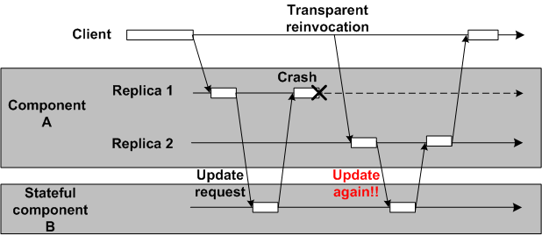
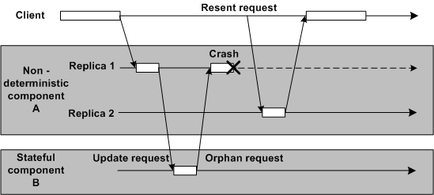
Exactly-once Semantics, Failures, & Determinism
Deterministic component A
  Caching of request/reply at component B is sufficient
Caching of
request/reply
rectifies the problem
Non-deterministic component A
Two possibilities upon failover
  No invocation
  Different invocation
Caching of request/reply does not help
  Non-deterministic code must re-execute
Orphan request & orphan state
Notes:
Solution to rectify the side-effects of replication depends upon whether system is deterministic or non-deterministic.

Slide 10
Presentation Road-map
Overview of the Contributions
Replication & The Orphan Request Problem
  Related Research & Unresolved Challenges
  Solution: Group Failover
Typed Traversal
  Related Research & Unresolved Challenges
  Solution: LEESA
Concluding Remarks
Notes:
10
With that background of the orphan request problem, we’ll now review the related research.

Slide 11
Related Research: End-to-end Reliability
Category | Related Research (The Orphan Request Problem)
Integrated transaction & replication | Reconciling Replication & Transactions for the End-to-End Reliability of CORBA Applications by P. Felber & P. Narasimhan Transactional Exactly-Once by S. Frølund & R. Guerraoui ITRA: Inter-Tier Relationship Architecture for End-to-end QoS by E. Dekel & G. Goft Preventing orphan requests in the context of replicated invocation by Stefan Pleisch & Arnas Kupsys & Andre Schiper Preventing orphan requests by integrating replication & transactions by H. Kolltveit & S. olaf Hvasshovd
Enforcing determinism | Using Program Analysis to Identify & Compensate for Nondeterminism in Fault-Tolerant, Replicated Systems by J. Slember & P. Narasimhan Living with nondeterminism in replicated middleware applications by J. Slember & P. Narasimhan Deterministic Scheduling for Transactional Multithreaded Replicas by R. Jimenez-peris, M. Patino-Martínez, S. Arevalo, & J. Carlos A Preemptive Deterministic Scheduling Algorithm for Multithreaded Replicas by C. Basile, Z. Kalbarczyk, & R. Iyer Replica Determinism in Fault-Tolerant Real-Time Systems by S. Poledna Protocols for End-to-End Reliability in Multi-Tier Systems by P. Romano
Database in the last tier
Deterministic scheduling
Program analysis to compensate nondeterminism
11

Slide 12
Unresolved Challenges: End-to-end Reliability of
Non-deterministic Stateful Components
Enforcing determinism
  Point solutions: Compensate specific sources of non-determinism
    e.g., thread scheduling, mutual exclusion
  Compensation using semi-automated program analysis
    Humans must rectify non-automated compensation
Enforce Determinism

Slide 13
Unresolved Challenges: End-to-end Reliability of
Non-deterministic Stateful Components
Integration of replication & transactions
  Applicable to multi-tier transactional web-based systems only
  Overhead of transactions (fault-free situation)
    Messaging overhead in the critical path (e.g., create, join)
    2 phase commit (2PC) protocol at the end of invocation
Transaction Manager
Create
Join
Join
Join

Slide 14
Unresolved Challenges: End-to-end Reliability of
Non-deterministic Stateful Components
Integration of replication & transactions
  Applicable to multi-tier transactional web-based systems only
  Overhead of transactions (fault-free situation)
    Messaging overhead in the critical path (e.g., create, join)
    2 phase commit (2PC) protocol at the end of invocation
  Overhead of transactions (faulty situation)
    Must rollback to avoid orphan state
    Re-execute & 2PC again upon recovery
  Transactional semantics are not transparent
    Developers must implement: prepare, commit, rollback
State Update
State Update
State Update
Potential
orphan
state
growing
Orphan state bounded in B, C, D

Slide 15
Solution: The Group-failover Protocol
Orphan state bounded in a group of components
Group
failover
Passive Replica
Protocol characteristics:
  Supports exactly-once execution semantics in presence of
    Nested invocation, non-deterministic stateful components, passive replication
  Ensures state consistency of replicas
  Does not require intrusive changes to the component implementation
    No need to implement prepare, commit, & rollback
  Supports fast client failover that is insensitive to
    Location of failure in the operational string
    Size of the operational string
Notes:
We came up with the group-failover protocol. The key characteristic of group-failover protocol is that the failover granularity is greater than 1. Instead of a single component failover, there is group-failover.

Slide 16
The Group-failover Protocol (1/3)
Constituents of the group-failover protocol
  Accurate failure detection
  Transparent failover
  Identifying orphan components
  Eliminating orphan components
  Ensuring state consistency
Timely fashion
Notes:
To ensure these characteristics, five things must take place accurately in group-failover

Slide 17
The Group-failover Protocol (1/3)
Constituents of the group-failover protocol
  Accurate failure detection
  Transparent failover
  Identifying orphan components
  Eliminating orphan components
  Ensuring state consistency
Accurate failure detection
  Fault-monitoring infrastructure based on heart-beats
  Synthesized using model-to-model transformations in GRAFT
Timely fashion
Notes:
To ensure these characteristics, five things must take place accurately in group-failover

Slide 18
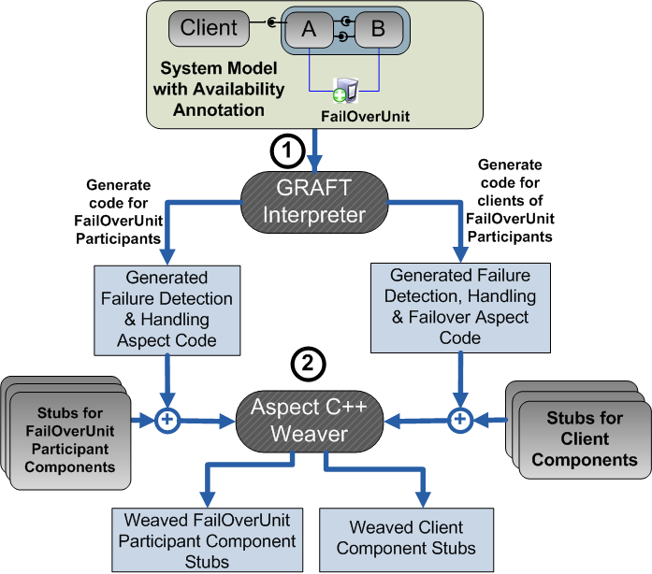
The Group-failover Protocol (1/3)
Constituents of the group-failover protocol
  Accurate failure detection
  Transparent failover
  Identifying orphan components
  Eliminating orphan components
  Ensuring state consistency
Accurate failure detection
  Fault-monitoring infrastructure based on heart-beats
  Synthesized using model-to-model transformations in GRAFT
Transparent failover alternatives
  Client-side request interceptors
    CORBA standard
  Aspect-oriented programming (AOP)
    Fault-masking code generation using model-to-code transformations in GRAFT
Timely fashion
Notes:
To ensure these characteristics, five things must take place accurately in group-failover

Slide 19
The Group-failover Protocol (2/3)
Identifying orphan components
  Without transactions, the run-time stage of a nested invocation is opaque
Transaction Manager
Create
Join
Join
Join

Slide 20
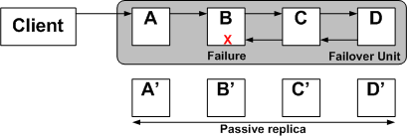
The Group-failover Protocol (2/3)
Identifying orphan components
  Without transactions, the run-time stage of a nested invocation is opaque
  Strategies for determining the extent of the orphan group (statically)
    The whole operational string
Potentially
non-isomorphic operational strings
Tolerates catastrophic faults
  Pool Failure
  Network failure
Tolerates Bohrbugs
  A Bohrbug repeats itself predictably when the same state reoccurs
Preventing Bohrbugs
  Reliability through diversity
  Diversity via non-isomorphic replication
  Different implementation, structure, QoS
Notes:
For identifying orphan components as well, we can exploit model-driven techniques …. To overcome that problem we came up with static strategies to determine the extent of the orphan group.

Slide 21
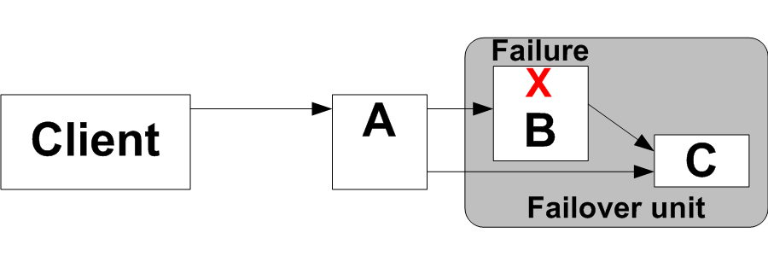
The Group-failover Protocol (2/3)
Identifying orphan components
  Without transactions, the run-time stage of a nested invocation is opaque
  Strategies for determining the extent of the orphan group (statically)
    The whole operational string
    Dataflow-aware component grouping

Slide 22
The Group-failover Protocol (3/3)
Eliminating orphan components
  Using deployment and configuration (D&C) infrastructure
  Invoke component life-cycle operations (e.g., activate, passivate)
  Passivation:
    Discards the application-specific state
    Component is no longer remotely addressable
Ensuring state consistency
  Must assure exactly-once semantics
  State must be transferred atomically
  Strategies for state synchronization
Strategies | Eager | Lag-by-one
Fault-free scenario | Messaging overhead | No overhead
Faulty scenario (recovery) | No overhead | Messaging overhead

Slide 23
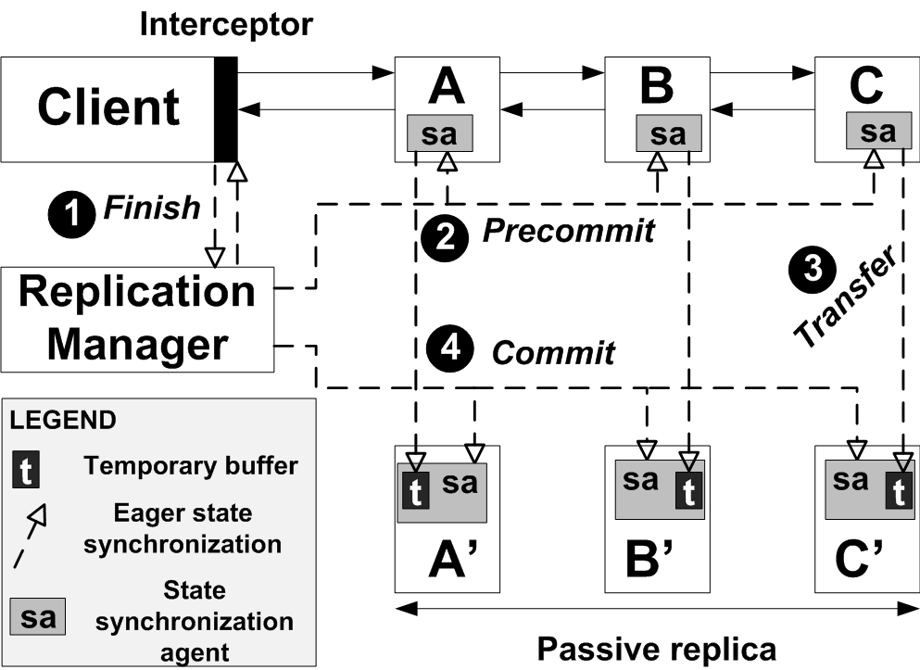
Eager State Synchronization Strategy
State synchronization in two explicit phases
Fault-free Scenario messages: Finish , Precommit (phase 1), State transfer, Commit (phase 2)
Faulty-scenario: Transparent failover

Slide 24
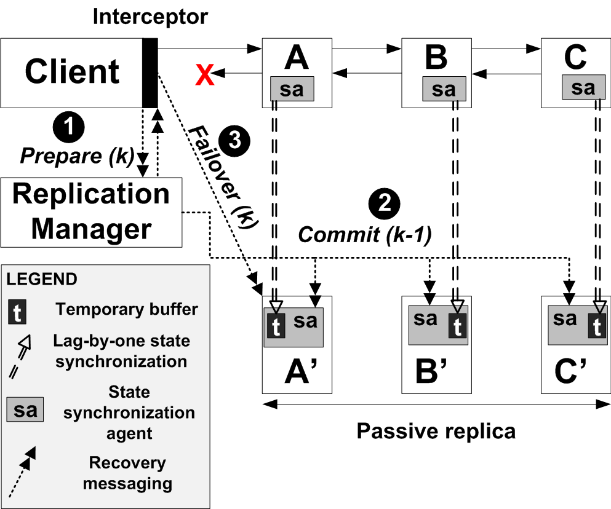
Lag-by-one State Synchronization Strategy
No explicit phases
Fault-free scenario messages: Lazy state transfer
Faulty-scenario messages: Prepare, Commit, Transparent failover

Slide 25
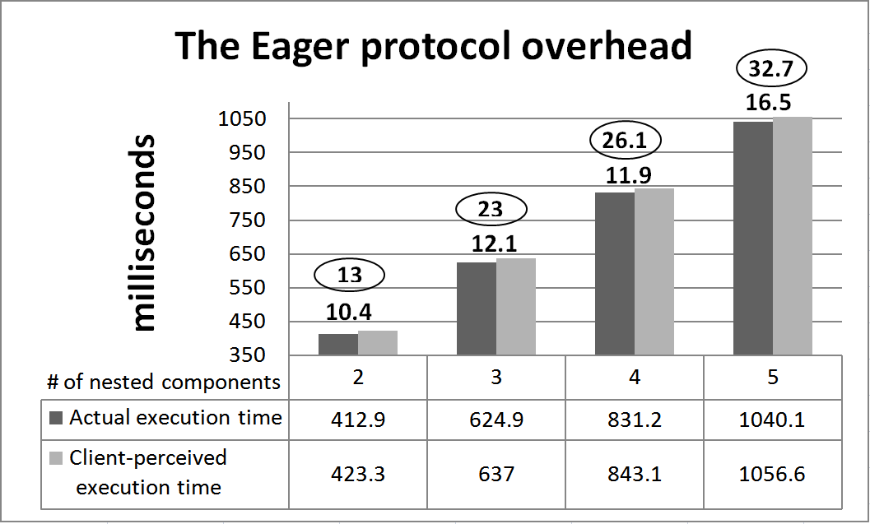
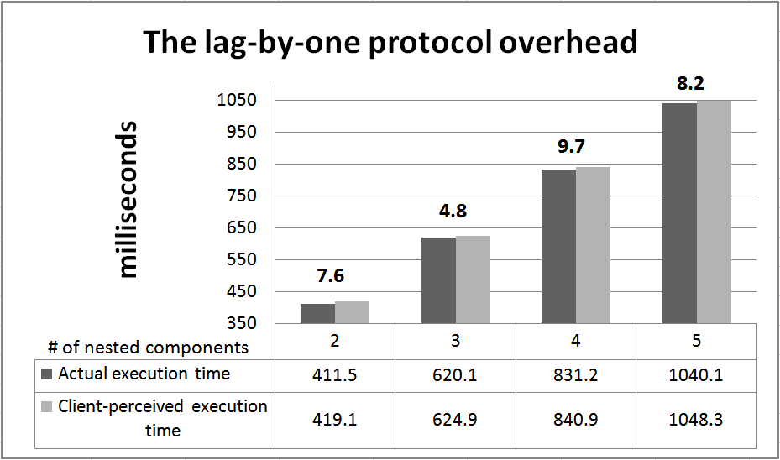
Evaluation: Overhead of the State Synchronization Strategies
Experiments
  CIAO middleware
  2 to 5 components
Eager state synchronization
  Insensitive to the # of components
  Concurrent state transfer using CORBA AMI (Asynchronous Messaging)
Lag-by-one state synchronization
  Insensitive to the # of components
  Fault-free overhead less than the eager protocol

Slide 26
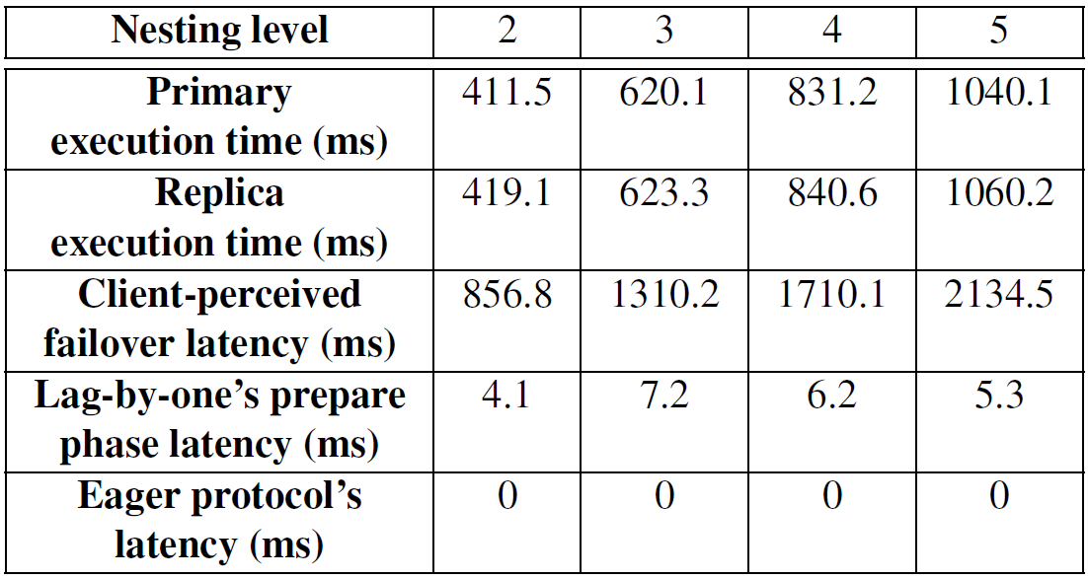
Evaluation: Client-perceived failover latency of the Synchronization Strategies
The Lag-by-one protocol has messaging (low) overhead during failure recovery
The eager protocol has no overhead during failure recovery
(Jitter +/- 3%)

Slide 27
Presentation Road-map
Overview of the Contributions
Replication & The Orphan Request Problem
  Related Research & Unresolved Challenges
  Solution: Group Failover
Typed Traversal
  Related Research & Unresolved Challenges
  Solution: LEESA
Concluding Remarks
Notes:
27

Slide 28
Role of Object Structure Traversals in the Development Lifecycle
Model-driven Development Lifecycle
Object structure traversals
  Required in all phases of the development lifecycle.
Specification
Model transformation
Composition
Model Traversals
Model interpretation
Object Structure Traversals
Deployment
XML Processing
XML Tree Traversals
Configuration
XML Processing
Run-time
Notes:
During the course of earlier research, I observed that object structure traversals are needed in all the phases of lifecycle. They manifest in two forms. First is model traversals needed for model transformation & model interpretation. Secondly, for XML processing for configuration of middleware.

Slide 29
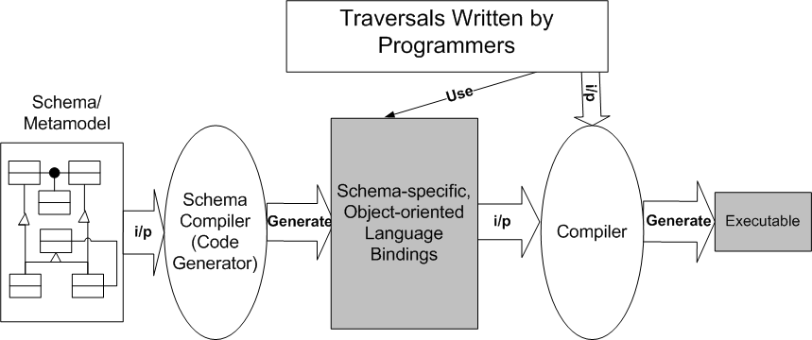
Object Structure Traversal and Object-oriented Languages
Object structures
  Often governed by a statically known schema (e.g., XSD, MetaGME)
Data-binding tools (e.g., UDM)
  Generate schema-specific object-oriented language bindings
  Use well-known design patterns
    Composite for hierarchical representation
    Visitor for type-specific actions
Such applications are known as schema-first applications
Notes:
These object structures are often governed by a static schema…. For improved type-safety, data-binding tools are used….

Slide 30
Challenges in Schema-first Applications
Sacrifice traversal idioms for type-safety
  Succinctness (axis-oriented expressions)
    Find all author names in a book catalog (XPath child axis)
  “/catalog/book/author/name”
  Structure-shyness (resilience to schema evolution)
    Find names anywhere in the book catalog (XPath descendant axis)
  “//name”
Highly repetitive, verbose traversal code
  Schema-specificity --- each class has a different interface
  Intent is lost due to code bloat
Tangling of traversal specifications with type-specific actions
  The “visit-all” semantics of the classic visitor are inefficient and insufficient
  Lack of reusability of traversal specifications and visitors
Is it possible to achieve type-safety of OO and the succinctness of XPath together?
Notes:
However there are challenges in developing schema-first application in this way…

Slide 31
Related Research
Approach | Advantage | Limitation
XPath, XSLT, XQuery | Domain-specific, intuitive, succinct, structure-shy, schema-aware (XSD v2.0) | Tangling persists, XML-specific, “string-encoded” integration in GPL, only run-time error identification
External DSLs (e.g., Gray, Ovlinger et al.) | Tangling addressed, intuitive, domain-specific, schema-aware | extra code generation step, high language development cost, coarse granularity of integration with existing code
Strategic programming (e.g. Stratego, Visitor-based) | Tangling addressed, generic reusable traversals, structure-shy | Efficiency concerns, limited schema conformance checking
Adaptive Programming (Lieberherr et al.) | Tangling addressed, efficient, early schema conformance checking, structure-shy | Limited traversal control

Slide 32
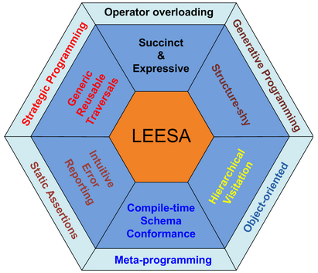
Solution: LEESA
Language for Embedded QuEry and TraverSAl
Multi-paradigm Design in C++

Slide 33
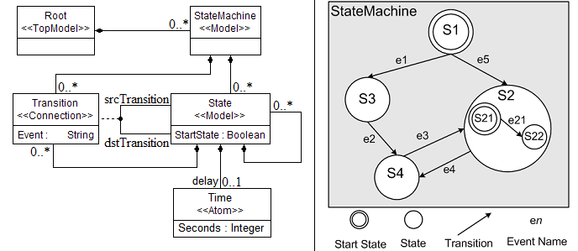
LEESA by Examples
State Machine: A simple composite object structure
  Recursive: A state may contain other states and transitions

Slide 34
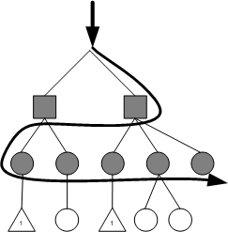
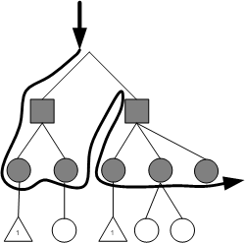
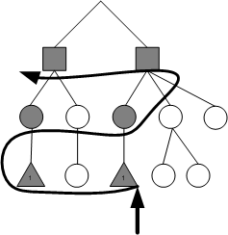
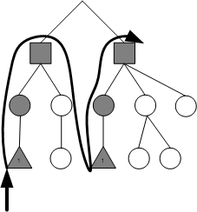
Axis-oriented Traversals (1/2)
Child Axis (breadth-first)
Child Axis (depth-first)
Parent Axis (breadth-first)
Parent Axis (depth-first)
Root() >> StateMachine() >> v >> State() >> v
Root() >>= StateMachine() >> v >>= State() >> v
Time() << v << State() << v << StateMachine() << v
Time() << v <<= State() << v <<= StateMachine() << v
User-defined visitor object

Slide 35
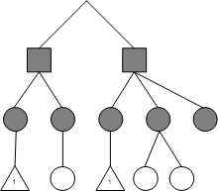
Axis-oriented Traversals (2/2)
Descendants
More axes in LEESA
  Child, parent, descendant, ancestor,
  association, sibling (tuplification)
Key features of axis-oriented expressions
  Succinct and expressive
  Type checked (not string encoded)
  Separation of type-specific actions from traversals
  Composable
  First class support (can be named and passed around as parameters)
But all these axis-oriented expressions are hardly enough!
  LEESA’s axes traversal operators (>>, >>=, <<, <<=) are reusable but …
  Programmer written axis-oriented traversals are not!
  Also, where is recursion?
Siblings

Slide 36
Adopting Strategic Programming (SP)
Adopting Strategic Programming (SP) Paradigm
  Began as a term rewriting language: Stratego
  Generic, reusable, recursive traversals independent of the structure
  A small set of basic combinators
Identity | No change in input | Choice <S1, S2> | If S1 fails apply S2
Fail | Throw an exception | All<S> | Apply S to all immediate children
Seq<S1,S2> | Apply S1 then S2 | One<S> | Apply S to only one child

Slide 37
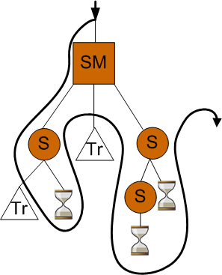
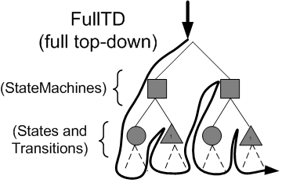
Strategic Programming (SP) Continued
Higher-level recursive traversal schemes can be composed
Generic Top-down traversal
  E.g., Visit everything under Root
TopDown<S> | Seq<S,All<TopDown>>
Lacks schema awareness
  Inefficient traversal
  E.g., Visit all Time objects
Not smart enough!

Slide 38
Schema-aware Structure-shy Traversal using LEESA
Generic top-down traversal using hierarchical visitor
  E.g., Visit everything (recursively) under Root
Avoids unnecessary sub-structure traversal
Descendant and ancestor axes
  E.g., Find all the Time objects (recursively) under Root
Emulating XPath wildcards
  E.g., Find all the Time objects exactly three levels below Root.
Root()>> TopDown(Root(), VisitStrategy(v), LeaveStrategy(v))
Root() >> DescendantsOf(Root(), Time())
Root() >> LevelDescendantsOf(Root(), _, _, Time())
Schema-specific extensions to the C++ type system!

Slide 39
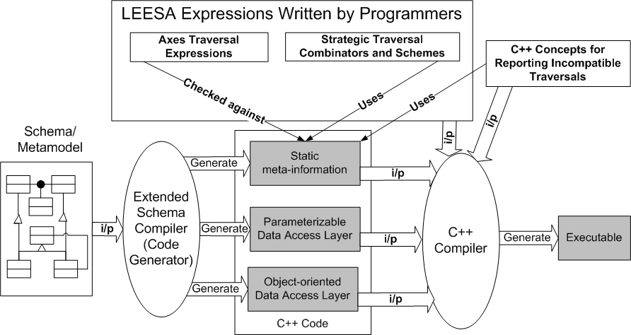
Multi-paradigm Design of LEESA
C++ operator overloading
Generic programming
Strategic programming
Meta-programming
Hides
schema-specificity
Notes:
All this magic is made possible due to an extension of the schema-driven development process

Slide 40
Layered Architecture of LEESA
Application Code
Programmer-written traversals
Strategic Traversal Combinators and Schemes
Schema independent generic traversals
Focus on schema types, axes, & actions only
Axes Traversal Expressions
A C++ idiom for lazy evaluation of expressions
LEESA Expression Templates
(Parameterizable) Generic
Data Access Layer
Schema independent generic interface
Object-oriented Data
Access Layer
OO Data Access API (e.g., XML data binding)
In memory representation of object structure
Object Structure
A giant machinery for unary function-object generation and composition (higher-order programming)

Slide 41
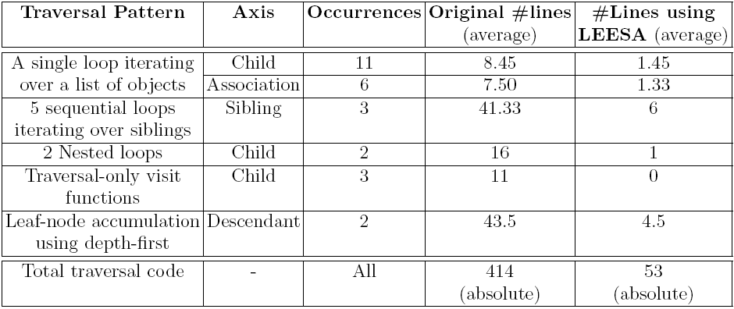
Reduction in Boilerplate Traversal Code
Experiment: Existing traversal code of a model interpreter was changed easily
87% reduction in traversal code
Notes:
Several traversal patterns were replaced by LEESA axis-oriented expressions

Slide 42
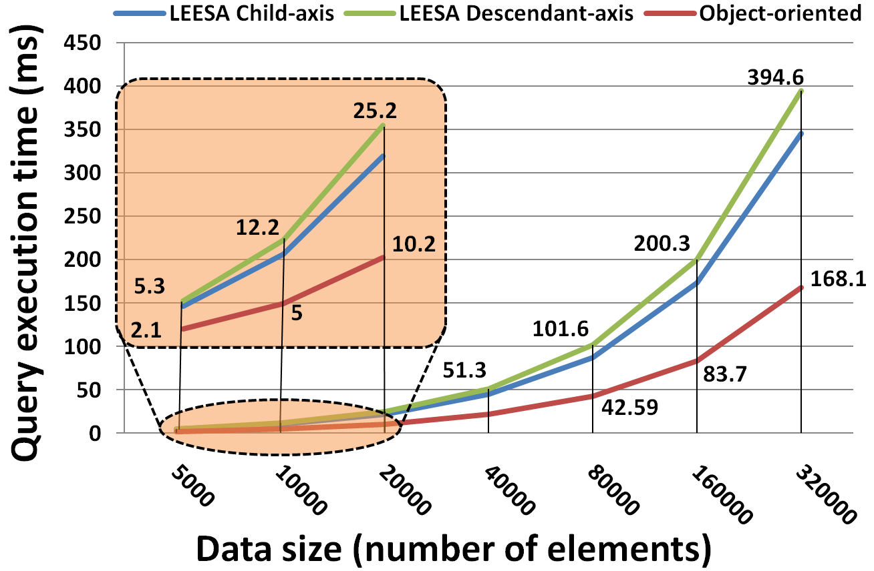
Run-time performance of LEESA
Abstraction penalty
  Memory allocation and de-allocation for internal data structures
33 seconds for file I/O 0.4 seconds for query

Slide 43
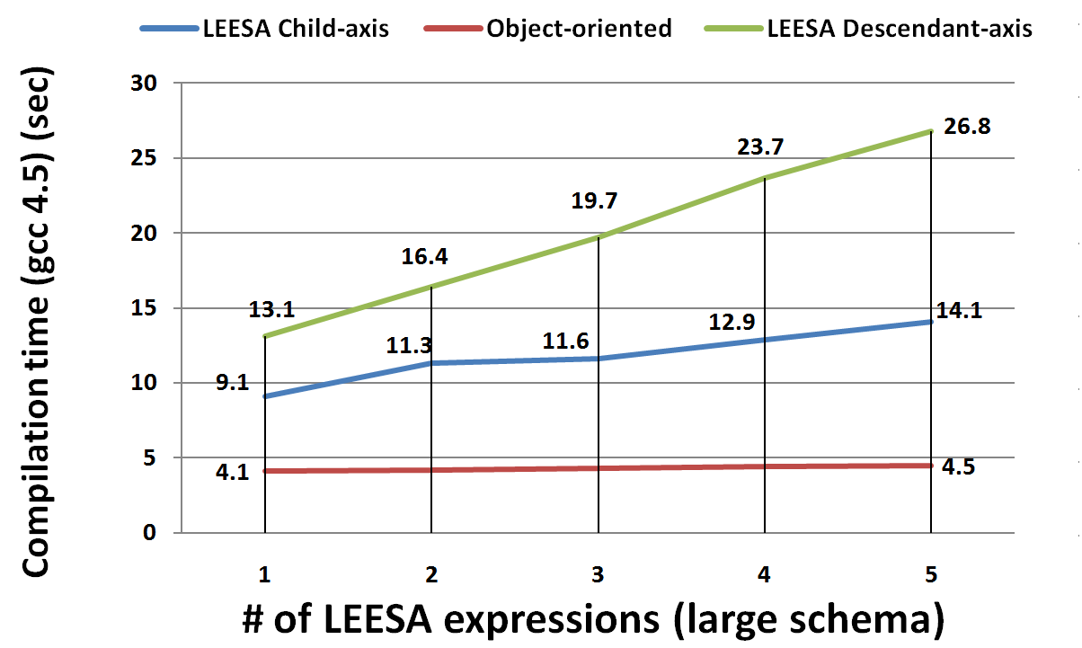
Compilation time (gcc 4.5)
Compilation time affects
  Edit-compile-test cycle
  Programmer productivity
Heavy template meta-programming in C++ is slow (today!)
(300 types)

Slide 44
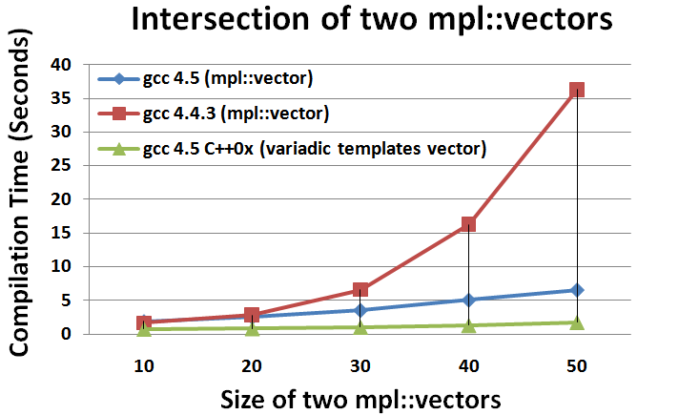
Compiler Speed Improvements (gcc)
Variadic templates
  Fast, scalable typelist manipulation
  Upcoming C++ language feature (C++0x)
  LEESA’s meta-programs use typelists heavily
Notes:
In short, better days are ahead for C++ meta-programming!

Slide 45
Venue | Overall Research Contributions
ISORC 2009 | Fault-tolerance for Component-based Systems - An Automated Middleware Specialization Approach
ECBS 2009 | CQML: Aspect-oriented Modeling for Modularizing & Weaving QoS Concerns in Component-based Systems
ISAS 2007 | MDDPro: Model-Driven Dependability Provisioning in Enterprise Distributed Real-Time & Embedded Systems
DSLWC 2009 | LEESA: Embedding Strategic & XPath-like Object Structure Traversals in C++
RTAS 2011 (to be submitted) | Rectifying Orphan Components using Group-failover for DRE systems
AQuSerM 2008 | Towards A QoS Modeling & Modularization Framework for Component Systems
RTWS 2006 | Model-driven Engineering for Development-time QoS Validation of Component-based Software Systems
DSPD 2008 | An Embedded Declarative Language for Hierarchical Object Structure Traversal
ISIS Tech. Report 2010 | Toward Native XML Processing Using Multi-paradigm Design in C++
RTAS 2009 | Adaptive Failover for Real-time Middleware with Passive Replication
RTAS 2008 | NetQoPE: A Model-driven Network QoS Provisioning Engine for Distributed Real-time & Embedded Systems
ECBS 2007 | Model-driven Engineering for Development-time QoS Validation of Component-based Software Systems
JSA Elsevier 2010 | Supporting Component-based Failover Units in Middleware for Distributed Real-time Embedded Systems
First-author
Other

Slide 46
Concluding Remarks
Operational string is a component-based model of distributed computing focused on end-to-end deadline
  Problem: Operational strings exhibit the orphan request problem
  Solution: Group-failover protocol
Schema-first applications are developed using OO-biased data binding tools
  Problem: Sacrificing traversal idioms and reusability for type-safety
  Solution: Multi-paradigm design in C++, LEESA

Slide 47
Dissertation Contributions: Model-driven Fault-tolerance Provisioning for Component-based DRE Systems
Component QoS Modeling Language (CQML)
  Aspect-oriented Modeling for Modularizing QoS Concerns
Specification
Composition
Generative Aspects for Fault-Tolerance (GRAFT)
  Multi-stage model-driven development process
  Weaves dependability concerns in system artifacts
  Provides model-to-model, model-to-text, model-to-code transformations
Deployment
Configuration
The Group-failover Protocol
  Resolves the orphan request problem
Run-time
Language for Embedded Query and Traversal (LEESA)
  Multi-paradigm design in C++ for object structure traversal
Model Traversal
47

Slide 48

Questions

Slide 49
Backup

Slide 50
Generic Data Access Layer / Meta-information
Automatically generated C++ classes from the StateMachine meta-model
T determines child type
class Root {
set<StateMachine> StateMachine_kind_children();
template <class T> set<T> children ();
typedef mpl::vector<StateMachine> Children;
};
class StateMachine {
set<State> State_kind_children();
set<Transition> Transition_kind_children();
template <class T> set<T> children ();
typedef mpl::vector<State, Transition> Children;
};
class State {
set<State> State_kind_children();
set<Transition> Transition_kind_children();
set<Time> Time_kind_children();
template <class T> set<T> children ();
typedef mpl::vector<State, Transition, Time> Children;
};
Externalized meta-information using C++ metaprogramming

Slide 51
Generic yet Schema-aware SP Primitives
LEESA’s All combinator uses externalized static meta-information
  All<Strategy> obtains children types of T generically using T::Children.
  Encapsulated metaprograms iterate over T::Children typelist
  For each child type, a child-axis expression obtains the children objects
  Parameter Strategy is applied on each child object
Opportunity for optimized substructure traversal
Eliminate unnecessary types from T::Children
DescendantsOf implemented as optimized TopDown.
DescendantsOf
(StateMachine(), Time())

Slide 52
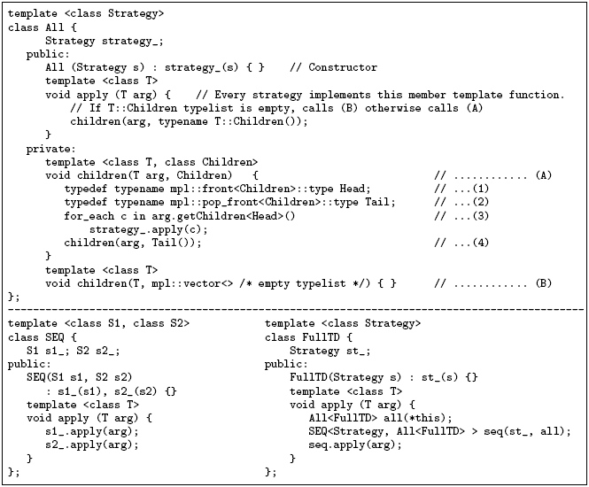
LEESA’s Strategic Programming Primitives

Slide 53
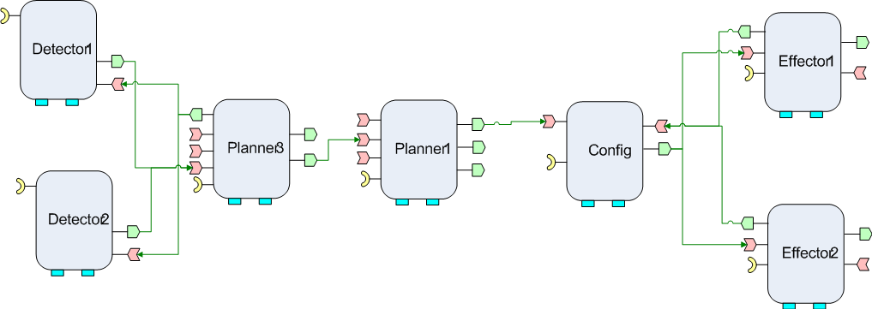
Wider Applicability of Group Failover (1/2)
Tolerates catastrophic faults (DoD-centric)
  Pool Failure
  Network failure
N
N
N
N
N
N
N
Whole operational string must
failover
Pool 1
N
N
Replica
N
Clients
N
N
N
N
N
Pool 2
Notes:
Conventionally …. The granularity of failover….
However, I’ll present 3 scenarios here that argue for failover granularity larger than a single component.

Slide 54
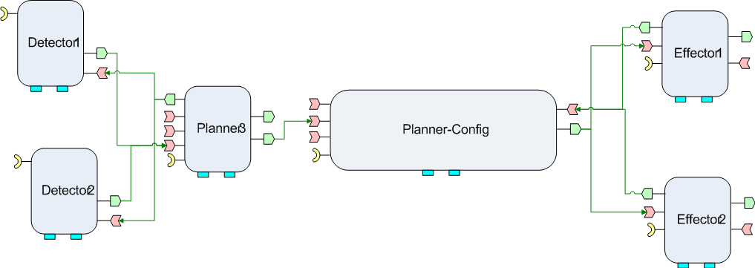
Wider Applicability of Group Failover (2/2)
Tolerates Bohrbugs
  A Bohrbug repeats itself predictably when the same state reoccurs
Strategy to Prevent Bohrbugs: Reliability through diversity
  Diversity via non-isomorphic replication
Non-isomorphic
work-flow
and
implementation
of Replica
Different
End-to-end
QoS
(thread pools, deadlines, priorities)
Whole operational string must failover

Slide 55
Implementing Schema Compatibility Checking and
Schema-aware Generic Traversal
C++ template meta-programming
  C++ templates – A turing complete, pure functional, meta-programming language
  Used to represent meta-information from the schema
Boost.MPL – A de facto library for C++ template meta-programming
  Typelist: Compile-time equivalent of run-time list data structure
  Metafunction: Search, iterate, manipulate typelists at compile-time
  Answer compile-time queries such as “is T present is the typelist?”
State::Children = mpl::vector<State,Transition,Time>
mpl::contains<State::Children, State>::value is TRUE

Slide 56
Intermediate Results Processing
Programmer-defined selection, sorting, filtering of intermediate results
Programmer-defined C++ functions/functors
In C++0x, lambda functions can be used
int comparator (State, State);
bool predicate (Time);
Root() >> StateMachine() >> State()
>> Sort(State(), comparator)
>> Time()
>> Select(Time(), predicate)

